Slide 1
ART 1600 – The Aesthetics of Architecture, Interiors, and Design Matthew Ziff, Associate Professor, Interior Architecture Area Chair Spring Semester 2017
Historical Overview: Part 2
Important Aesthetic Developments:
Late 1800’s - 1915

Slide 2
We classify developments in architecture, and design, as ‘movements’
An architecture, and design a movement is a tendency or style with a specific common philosophy or goal, held by a group during a designated period of time.
A movement may exist during the same time as other movements AND one movement may espouse contradictory, antithetical, points of view to another!

Slide 3
Art Nouveau 1890-1910 +-
An ornamental style of art and design that flourished between about 1890 and 1910 throughout Europe and the United States.
Art Nouveau is characterized by its use of a long, sinuous, organic line and was employed most often in architecture interior design, jewelry and glass design, posters, and illustration.
It was a deliberate attempt to create a new style, based on contemporary ideas, free of the imitative historicism that dominated much of 19th-century art and design.

Slide 4
Art Nouveau imagery: nature motifs, curvilinear, flowing

Slide 5
Art Nouveau
Organic, flowing lines, stylized plant designs, flower stems, tendrils, water lilies, asymmetrical shapes
Influenced by Japanese art prints
These visual elements were used in all types of design—wallpaper, jewelry, architecture, furniture, etc.

Slide 6
Art Nouveau imagery Paris metro station entry designed by Hector Guimard, 1900

Slide 7
Art Nouveau
Like the related Arts & Crafts movement, Art Nouveau “sought simpler, more honestly constructed forms based on the patterns of nature.”
Art Nouveau supporters had an ambivalent attitude to the modern age.
Developed as an international movement between 1895-1910

Slide 8
Some of the most influential designers of the Art Nouveau period include:
Charles Rennie Mackintosh
Hector Guimard
Louis Comfort Tiffany
Louis Sullivan
Antonio Gaudi
Rene Lalique
Victor Horta

Slide 9
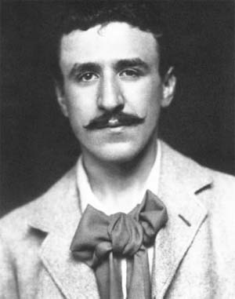
Charles Rennie Mackintosh (1868 – 1928) a 3 minute video
A Scottish architect, designer, watercolorist and artist.
He was a designer in the Arts and Crafts movement and also a main representative of Art Nouveau in the United Kingdom.

Slide 10
Charles Rennie Mackintosh (1868 – 1928)
Mackintosh’s career was a relatively short one, but of significant quality and impact.
All his major commissions were between 1896 and 1906, where he designed private homes, commercial buildings, interior renovations, church, and furniture.
He died on December 10, 1928 of throat cancer.

Slide 11
Mackintosh’s most significant design works includes:
Glasgow School of Art, 1909
Hill House, 1904
Willow Tea Rooms, 1896 – 1917
Furniture, especially the chairs
Watercolors

Slide 12
The Willow Tearooms, 1896 - 1917 Glasgow, Scotland
Within a four-story former warehouse building Mackintosh designed a range of spaces with different functions and decor for the Glasgow patrons to enjoy.
There was a ladies’ tearoom to the front of the ground floor, with a general lunch room to the back and a tea gallery above it

Slide 13
Willow Tea Room facade

Slide 14
Willow Tea Room interior

Slide 15
Mackintosh dining set, 1903

Slide 16
Macintosh drawings of Willow Tea Room furniture

Slide 17
Today after renovation

Slide 18
Mackintosh furniture

Slide 19
Mackintosh ‘Ladder Back’ chairs

Slide 20
Mackintosh wash stand,1904

Slide 21
Glasgow School of Art, 1909 designed by Charles Rennie Mackintosh

Slide 22
Main Entrance Glasgow School of Art

Slide 23
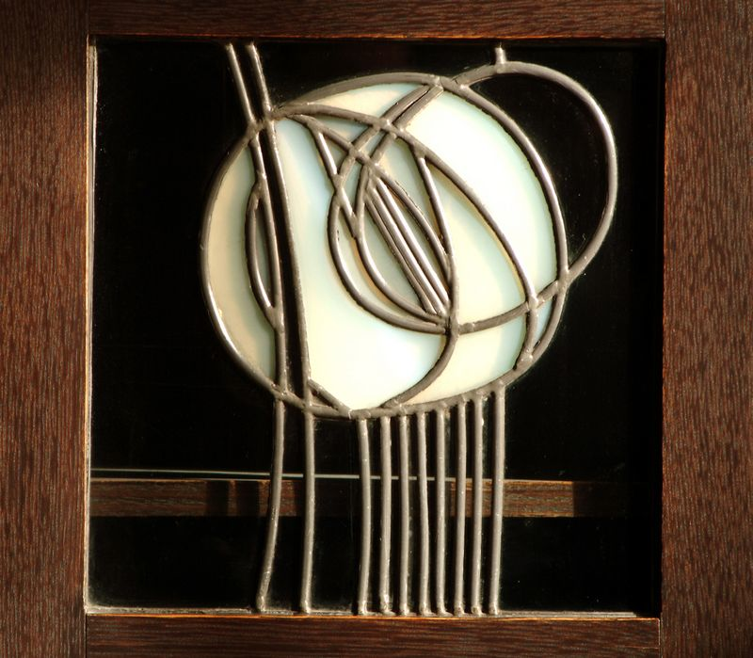
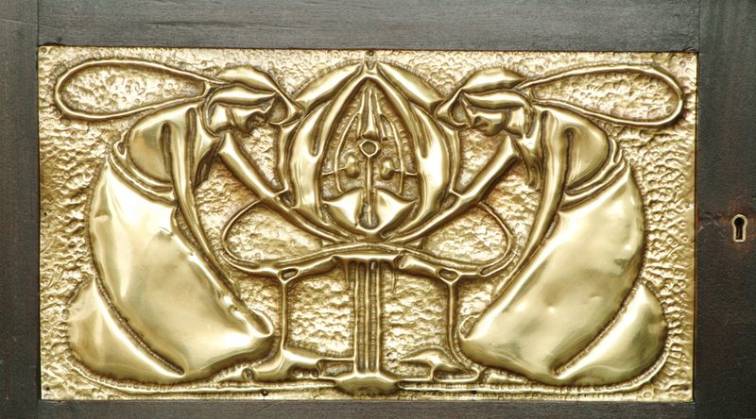
Details for the Glasgow School of Art by Mackintosh

Slide 24
Gallery space in the Glasgow School of Art Note how the structural frame of the skylight and roof are exposed and designed to be seen; they relate to other forms used elsewhere in the building.

Slide 25
“Hill House”, located in Helensburgh, Scotland, designed by Charles Rennie Mackintosh in 1904

Slide 27
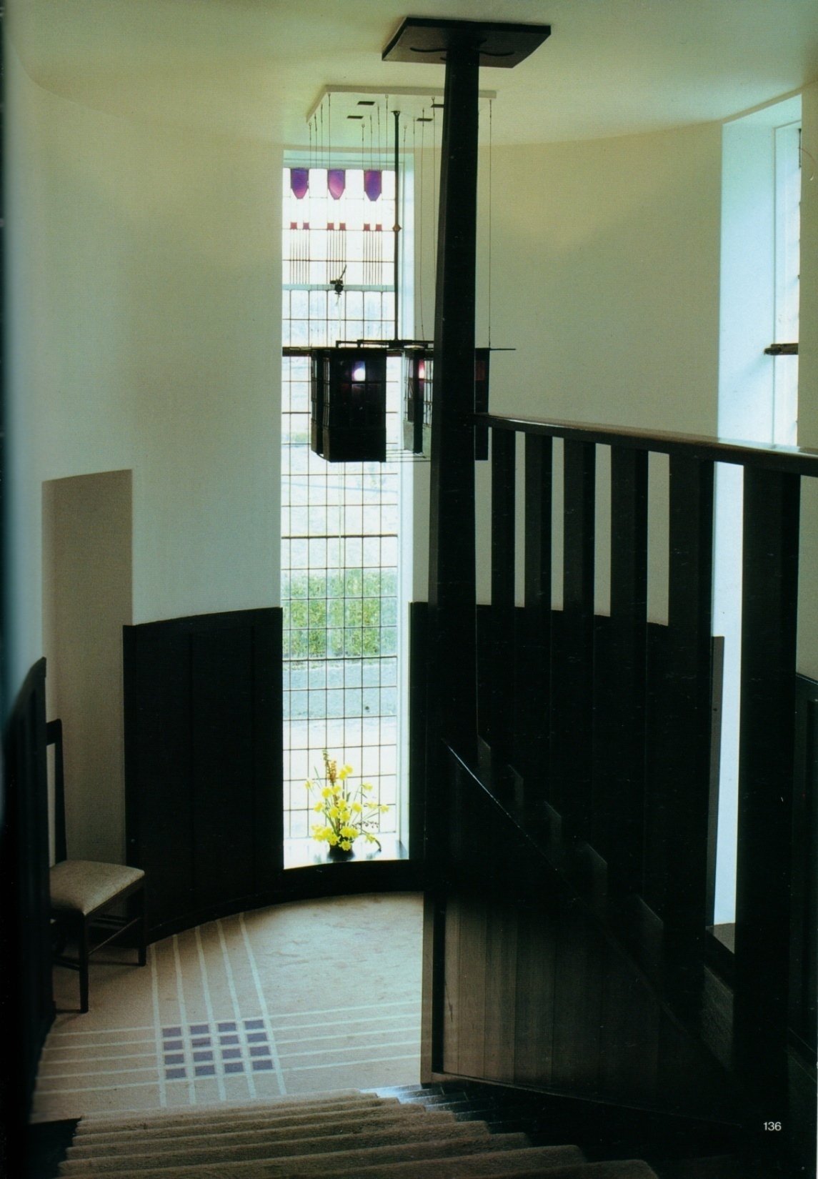

Slide 31
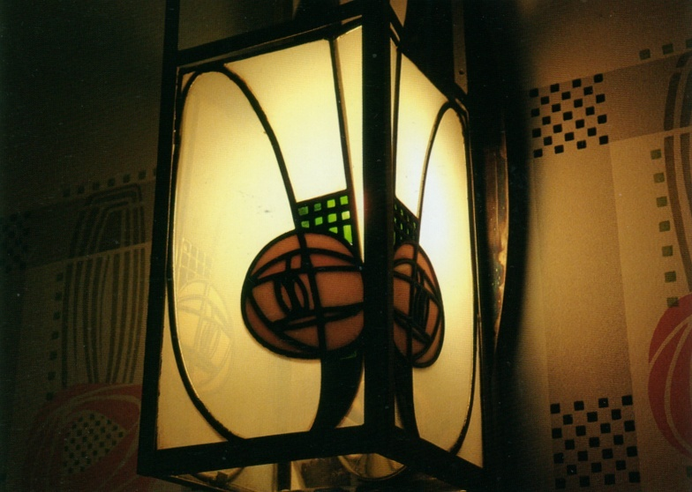
Macintosh furniture

Slide 32
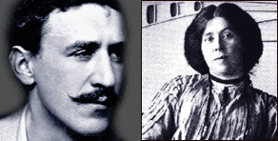
CHARLES RENNIE & MARGARET MACDONALD MACKINTOSH 1868 - 1928 1865 - 1933
From the earliest days of their professional and romantic partnership, Charles and Margaret were closely in synchronicity with each other.

Slide 33
Mackintosh watercolors

Slide 34
Mackintosh watercolors

Slide 35
Mackintosh watercolors

Slide 36
Mackintosh watercolors

Slide 37
Mackintosh watercolors

Slide 38
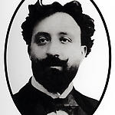
Hector Guimard 1867 - 1942
Hector Guimard was a French architect, who is a well known representative of the Art Nouveau style of the late nineteenth and early twentieth centuries.

Slide 39
Hector Guimard web page
Best known for his Paris Metro entrances, it is generally agreed that Hector Guimard introduced the Art Nouveau style to French architectural ironwork.
Hector Guimard in French web page

Slide 40
A custom designed fireplace surround made of enameled stoneware fashioned from reconstituted lava (6’ tall)

Slide 41
Hector Guimard

Slide 42
Hector Guimard

Slide 43
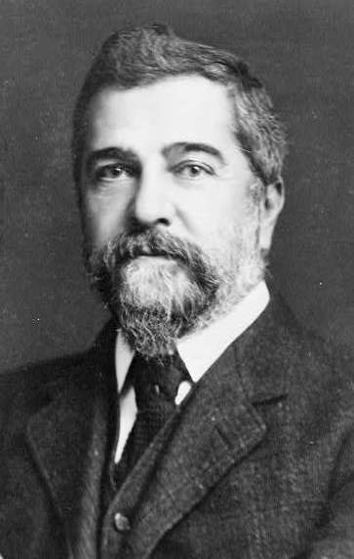
Louis Comfort Tiffany 1848 - 1943
American artist and designer who worked in the decorative arts and is best known for his work in stained glass.
He is the American artist most associated with the Art Nouveau movement.

Slide 44
‘Daffodil’ stained glass leaded lampshade

Slide 45
Close-up of a Tiffany Studios "Venetian" desk lamp, 1910-1920

Slide 46
An original Tiffany ‘Daffodil’ table lamp: sold for $24,000, January 2017.

Slide 47
Louis C. Tiffany: ‘Dogwood Blossom’ Table Lamp, circa 1906 $60,000

Slide 48
‘The Tree of Life’ stained glass panel

Slide 49
Tiffany stained glass window at Second Presbyterian Church (Chicago, Illinois)

Slide 50
Tiffany stained glass lamps Virginia Museum of Fine Arts, Richmond, VA

Slide 51
Tiffany’s ‘Wisteria’ table lamp

Slide 52
Louis Comfort Tiffany
Tiffany started out as a painter, but became interested in glassmaking from about 1875 and worked at several glasshouses in Brooklyn between then and 1878.
In 1879, he joined with Candace Wheeler, Samuel Colman and Lockwood de Forest to form Louis Comfort Tiffany and Associated American Artists.
Tiffany's leadership and talent, as well as his father's money and connections, led this business to thrive.
Wikipedia.org

Slide 53
Louis Comfort Tiffany
In 1881 Tiffany did the interior design of the Mark Twain House in Hartford, Connecticut, which still remains, but the new firm's most notable work came in 1882 when President Chester Alan Arthur refused to move into the White House until it had been re-decorated.
He commissioned Tiffany, who had begun to make a name for himself in New York society for the firm's interior design work, to redo the state rooms.
Wikipedia.org

Slide 54
Mark Twain (Samuel Clemens) house Hartford, Connecticut

Slide 55
Mark Twain (Samuel Clemens) house Hartford, Connecticut
The house was designed by Edward Tuckerman Potter, an architect from New York City.
The Clemens family lived in the house from the time it was built, in 1874, to 1986, when their daughter Susy died at home.

Slide 56
Mark Twain house
The home in Hartford later functioned as a school, an apartment building, and a library.
In 1962, the building was declared a National Historic Landmark.
Since 1974, it has had a multimillion-dollar renovation and an expansion dedicated to showcasing Twain's life and work.
The house faced financial troubles in 2008 due to construction cost overruns with its new museum center.
Since that time, the museum has rebounded to record-setting attendance and numbers of programs.

Slide 57
The upstairs ‘billiards’ room (where Mark Twain showed my grandfather, a high school student visiting the house on a school field trip, how to shoot pool)

Slide 59
Mark Twain house stairway

Slide 60
Mark Twain house

Slide 61
A Victorian style interior

Slide 62
A Victorian style interior

Slide 63
Mark Twain house

Slide 64
A mix of Arts & Crafts, Victorian, and Art Nouveau

Slide 65
Louis Comfort Tiffany, 1848-1933 “Magnolia and Irises” 1908

Slide 66
Tiffany Lamp
Dragonfly Motif
Base is as important as the shade

Slide 67
Art Nouveau
Use of new materials and techniques such as iron beams, cantilevering (products of Industrial Revolution)
Most designs were expensive—average person could not afford them

Slide 68
Louis Sullivan, architect1856 – 1924 Louis Sullivan overview with music by George Gershwin "Rhapsody in Blue"

Slide 69
Louis Sullivan
An American architect, and has been called the "father of skyscrapers” and "father of modernism”.
He is considered by many as the creator of the modern skyscraper, was an influential architect and critic of the Chicago School.
He was a mentor to Frank Lloyd Wright, and an inspiration to the Chicago group of architects who have come to be known as the Prairie School.

Slide 70
Art Nouveau
Louis Sullivan was the only major “architect” practitioner of Art Nouveau imagery in the US
People’s Bank, 1911, located in Sydney Ohio

Slide 72
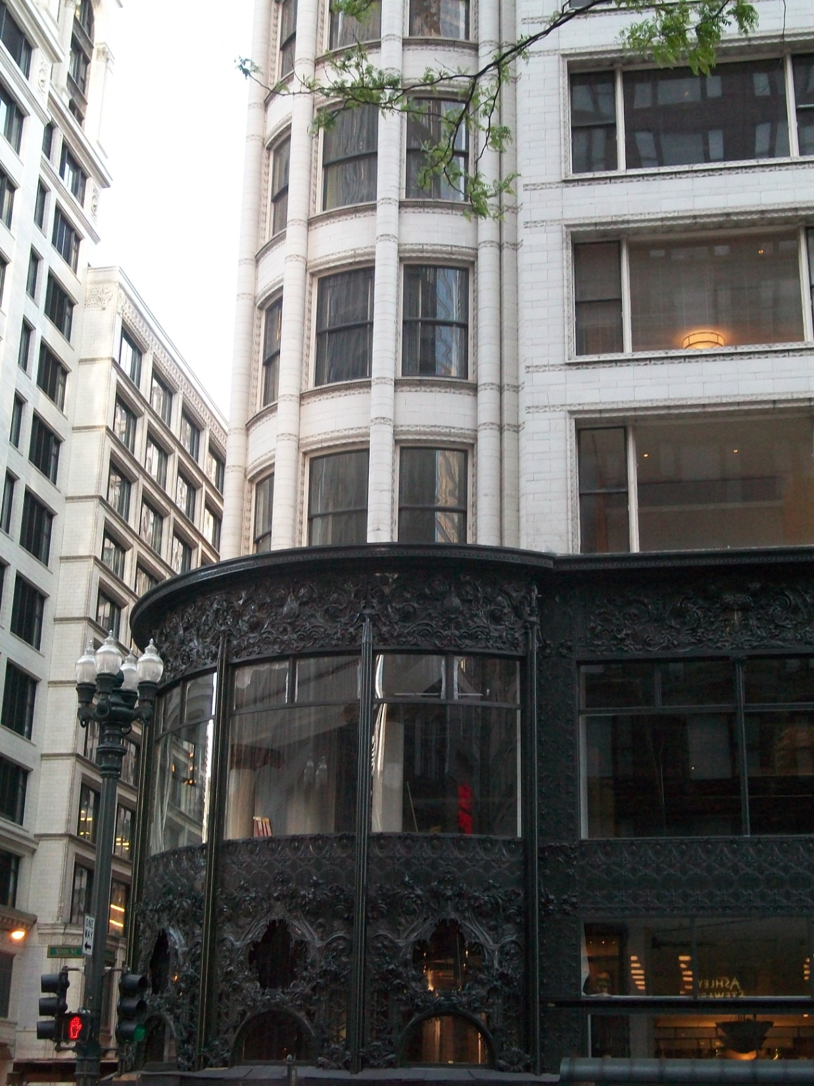
Carson Pirie Scott Department Store, Chicago
Louis Sullivan

Slide 73
Early Modern high rise building Louis Sullivan’s ‘Guaranty Building’ , Buffalo, NY, 1896 Louis Sullivan video

Slide 74
National Farmers Bank, Owatonna, MN

Slide 75
National Farmers Bank, Owatonna, MN

Slide 76
National Farmers Bank, Owatonna, MN

Slide 77
National Farmers Bank, Owatonna, MN

Slide 78
People's Savings and Loan Association Bank Sidney, Ohio, by Louis Sullivan

Slide 79
Merchant’s National Bank, Columbus, Wisconsin

Slide 80
Merchant’s National Bank, Columbus, Wisconsin

Slide 82
National Farmers Bank, Owatonna, MN

Slide 83
Merchant’s National Bank, Grinnell, Iowa

Slide 85
Terra cotta ornament

Slide 86
Farmers & Merchants Bank

Slide 87
Farmers & Merchants bank

Slide 88
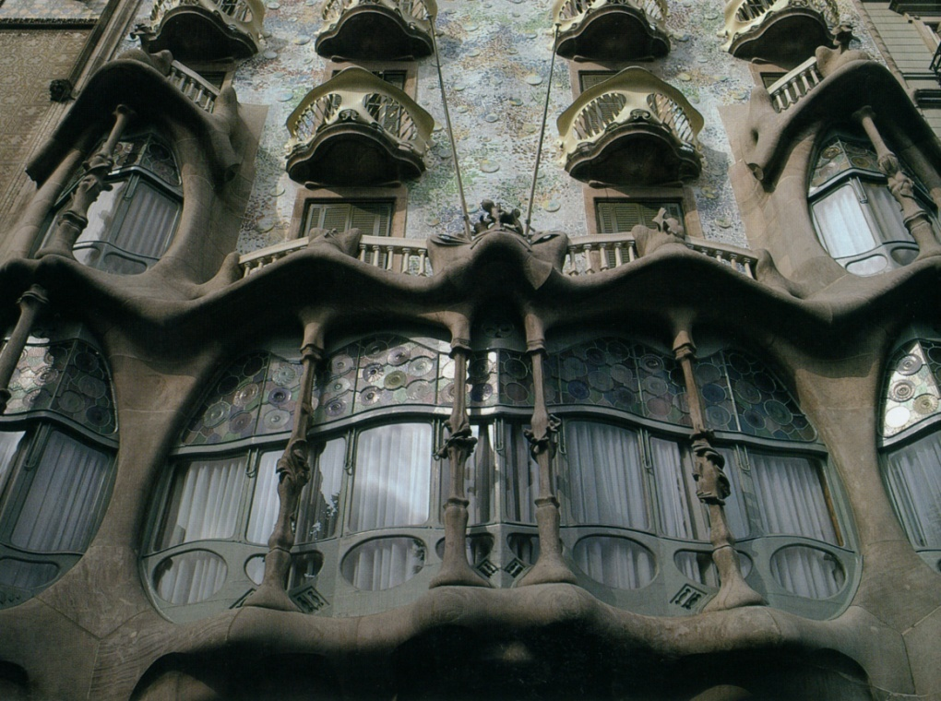
Casa Batllo, 1904, Barcelona, Spain, designed by Antonio Gaudi The following 7 slides are of the Casa Batllo

Slide 89
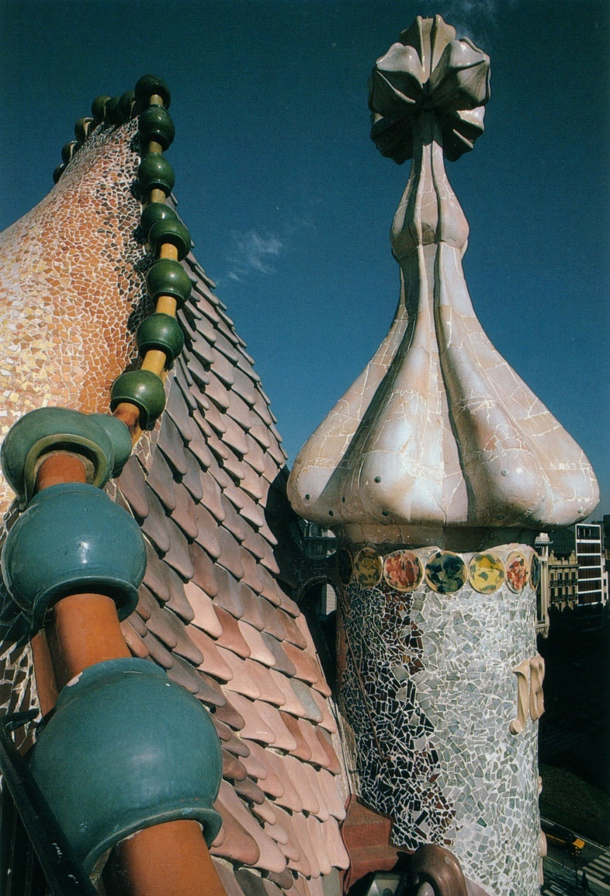
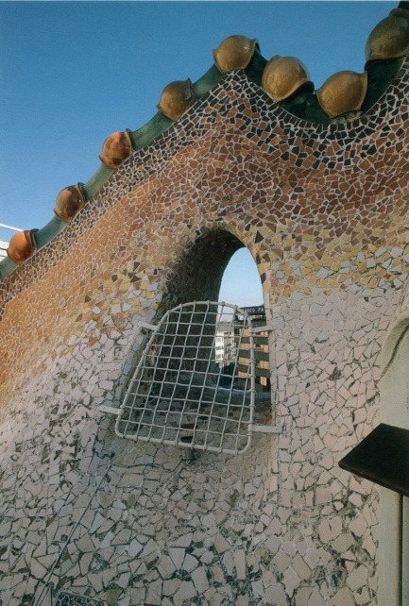

Slide 92
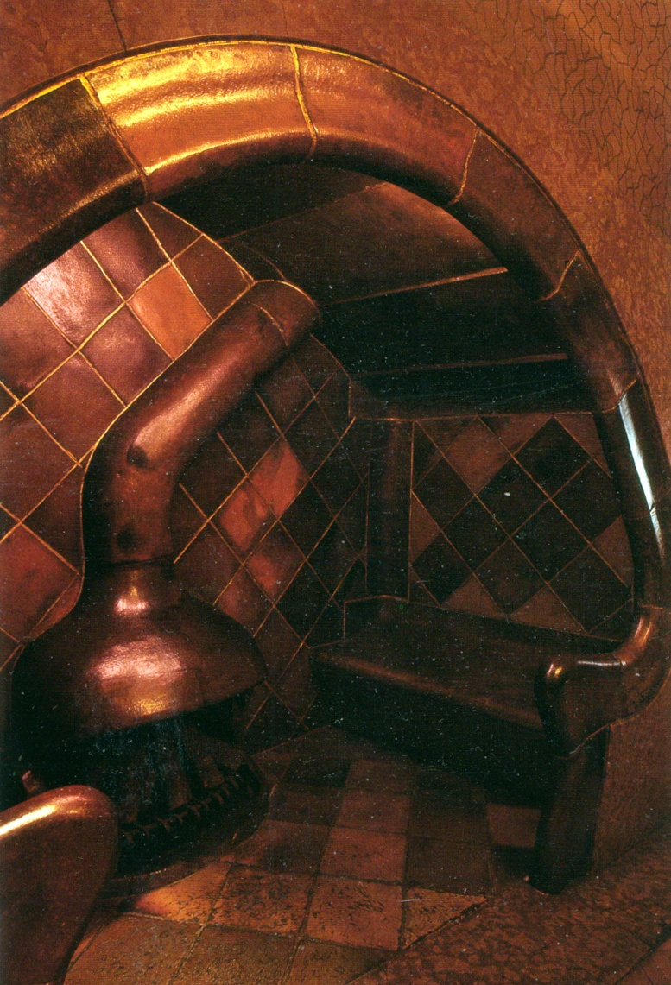

Slide 93
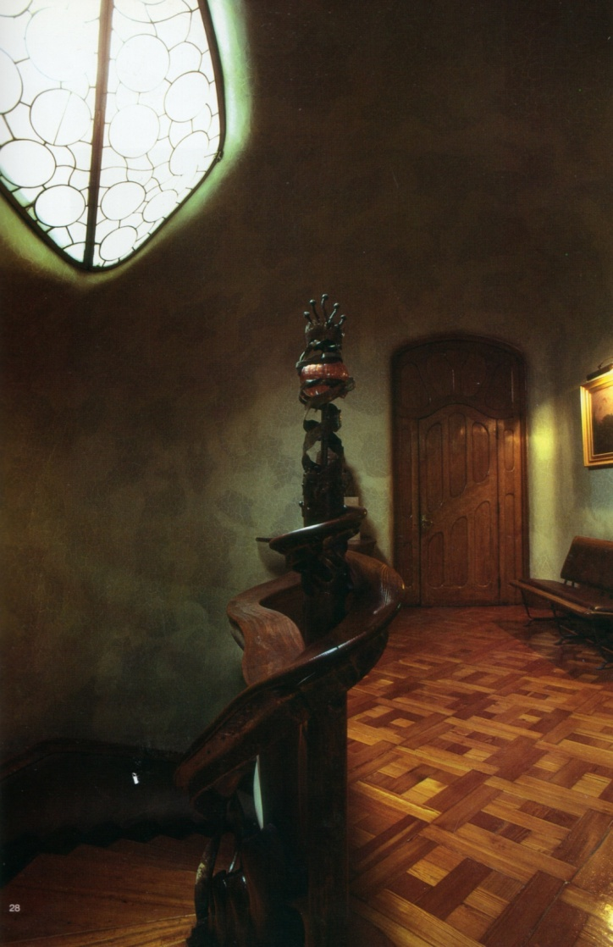
Asymmetrical
Serpentine Forms
Whiplash Curves

Slide 95
Casa Batllo floor plan

Slide 96
“Maison Horta”, located in Brussels, Belgium, designed by Belgian architect Victor Horta in 1901.

Slide 98
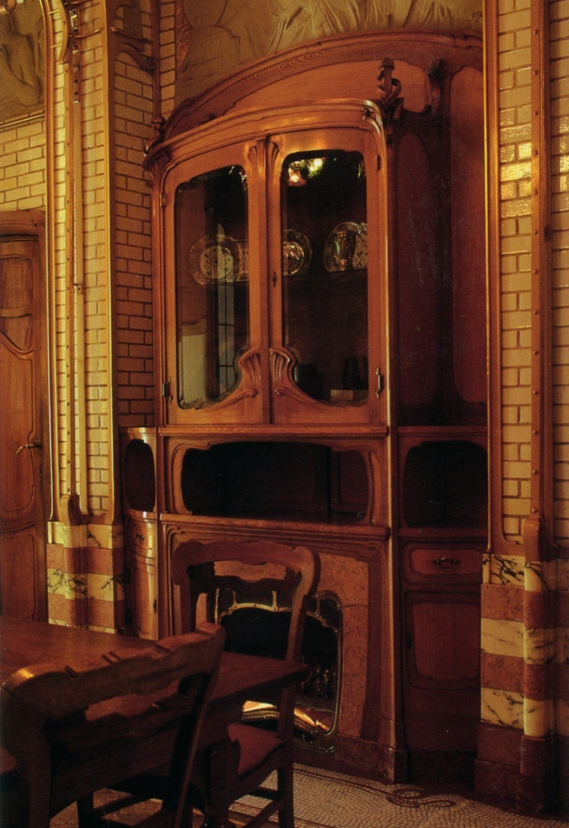
Asymmetrical
Serpentine Forms

Slide 102
Art Nouveau Artists
Gustave Klimt

Slide 103
“Adele Bloch-Bauer I” (1907), by Gustave Klimt sold for a record $135 million in 2006, Neue Galerie, New York

Slide 104
“The Embrace” by Gustav Klimt

Slide 105
Gustav Klimt Art Nouveau artist
Gustav Klimt (July 14, 1862 – February 6, 1918) was an Austrian symbolist painter and one of the most prominent members of the Vienna Secession movement.
Klimt is noted for his paintings, murals, sketches, and other objets d'art.
Klimt's primary subject was the female body, and his works are marked by a frank eroticism. In addition to his figurative works, which include allegories and portraits, he painted landscapes.
Among the artists of the Vienna Secession, Klimt was the most influenced by Japanese art and its methods.

Slide 106
“Hope II” 1907, Gustav Klimt

Slide 107
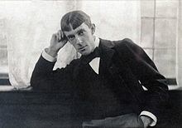
Aubrey Beardsley, 1872-1898
Aubrey Vincent Beardsley, 1872 – 1898, was an English illustrator and author.
He was a leading figure in the Aesthetic movement which also included Oscar Wilde and James A. McNeill Whistler.
Beardsley's contribution to the development of the Art Nouveau and poster styles was significant, despite the brevity of his career before his early death from tuberculosis.

Slide 108
Aubrey Beardsley “The Dancer's Reward” (Salome) by Aubrey Beardsley

Slide 109
The illustration for Oscar Wilde’s play Salome depicts Salome with the head of John the Baptist and justifies Beardsley’s reputation as one of the most controversial artists of the Art Nouveau movement.
His black ink drawings were dominated by dark themes and grotesque erotica, especially those that have been inspired by Japanese woodcuts.

Slide 110
Aubrey Beardsley “The Peacock Skirt” 1893

Slide 111
Aubrey Beardsley “Venus Between Terminal Gods”

Slide 112
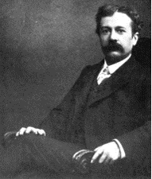
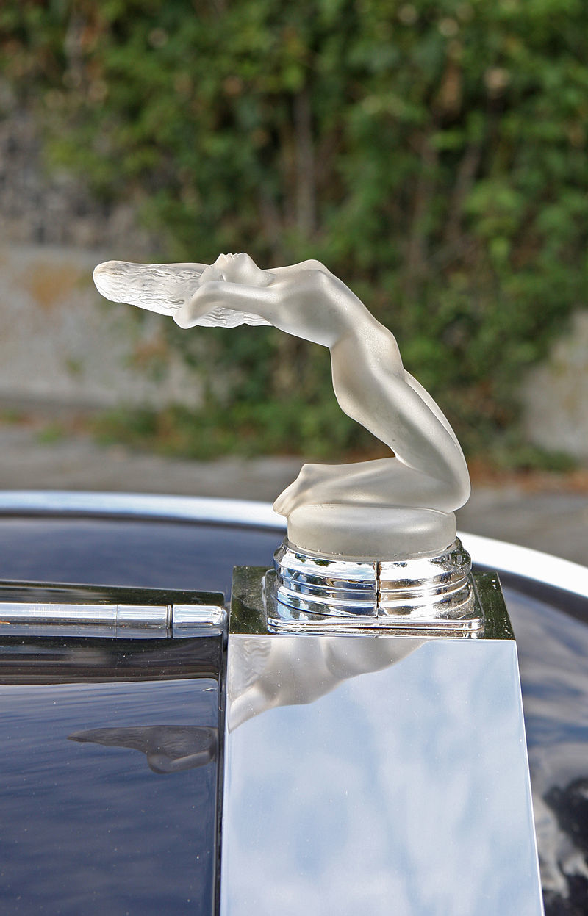
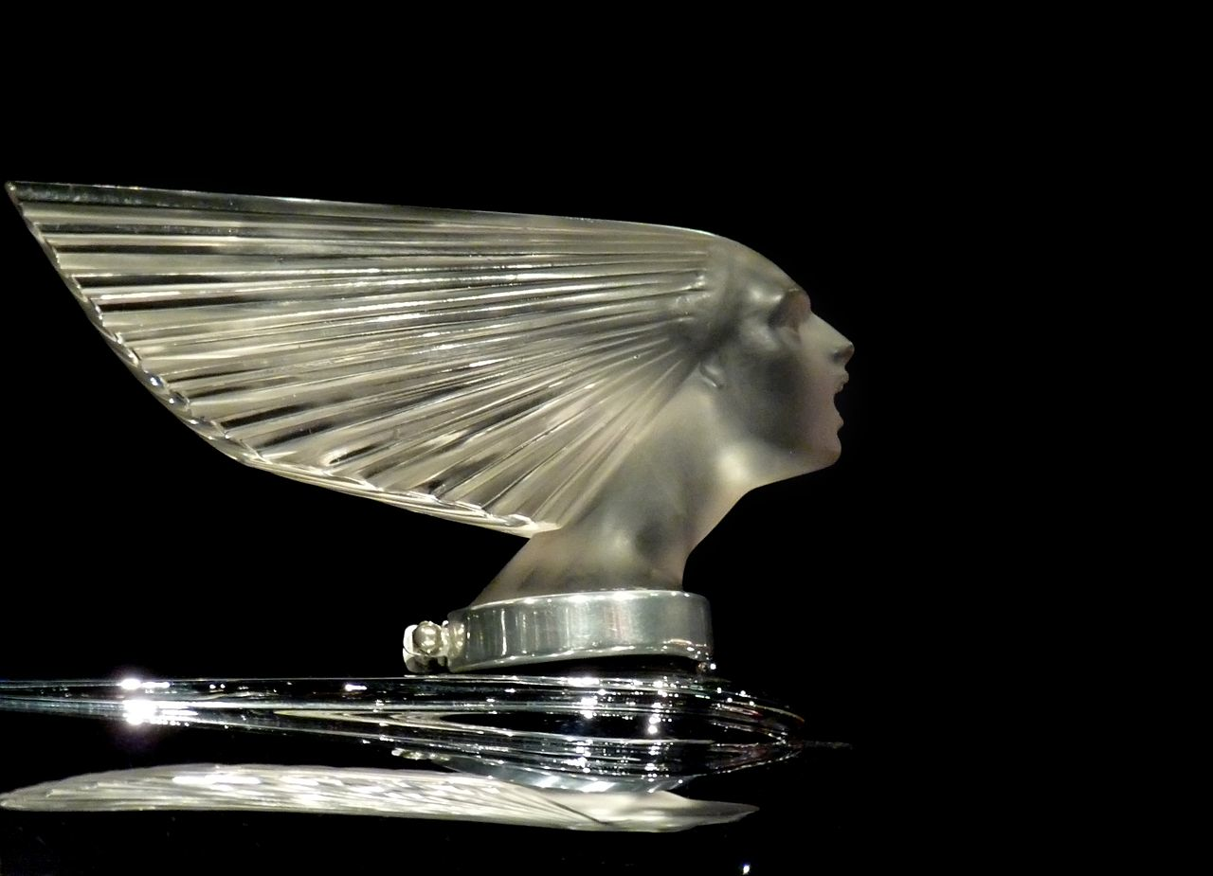
Rene Lalique
René Jules Lalique (1860 – 1945) was a French glass designer known for his creations of glass art, perfume bottles, vases, jewellry, chandeliers, clocks and automobile hood ornaments.

Slide 113
Rene Lalique Oiseau de Feu (Firebird), 1922

Slide 114
Rene Lalique web page
Rene Lalique Museum a 4 minute video in French

Slide 115
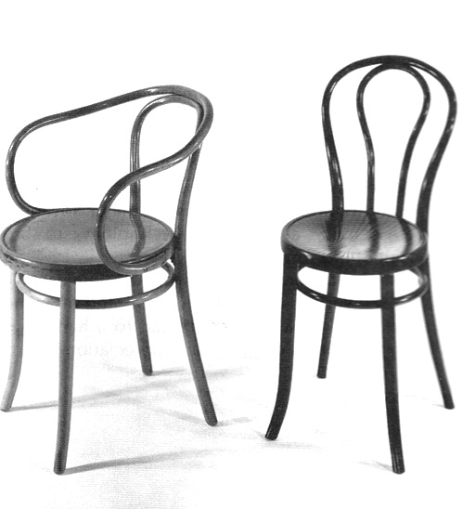
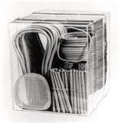
Michael Thonet
Some of the first to use mass production with furniture
Invented bentwood which is the application of steam to rods of beech wood and bending it into graceful shapes
Chairs light weight and were shipped “knocked down” and assembled on site

Slide 116
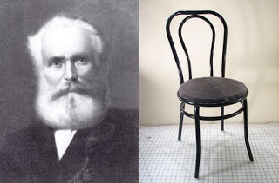
Michael Thonet, 1796-1871
Around 1830, Austrian cabinet-maker, Michael Thonet began experimenting with bending wood veneers for furniture construction, not just as a surface layer.
He created a process of gluing layers of veneers together and molding the sections into chair backs, beds, and couches.
He perfected his method of wood-bending, bending laminated parts of copper beech trees with steam, and created a production operation that produced up to 50,000 chairs in a year.

Slide 117
Michael Thonet
In the 1830s, Thonet began trying to make furniture out of glued and bent wooden slats.
His first success was the Bopparder Schichtholzstuhl (Boppard layerwood chair) in 1836.
Thonet's essential breakthrough was his success in having light, strong wood bent into curved, graceful shapes by forming the wood in hot steam.
This enabled him to design entirely novel, elegant, lightweight, durable and comfortable furniture, which appealed strongly to fashion - a complete departure from the heavy, carved designs of the past - and whose aesthetic and functional appeal remains to this day.

Slide 118
Thonet “Rocking Chair, Model 1” 1860

Slide 119
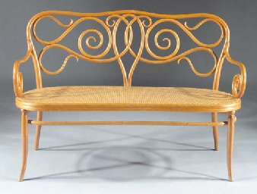
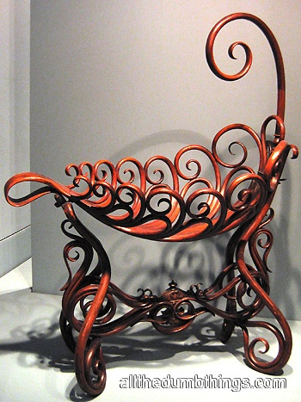
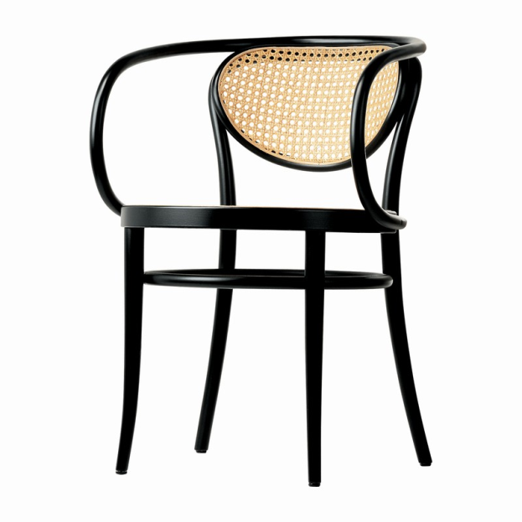
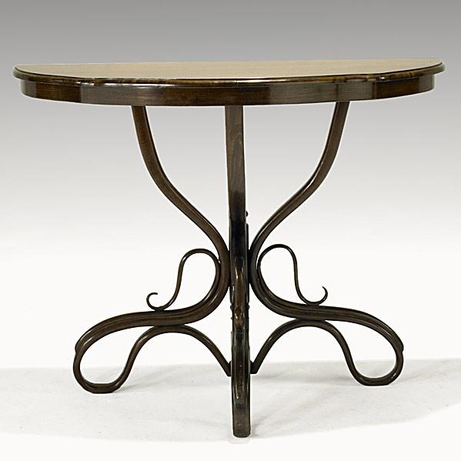

Slide 120
Thonet bentwood chair

Slide 121
Thonet Armchair No. 6009

Slide 122
Thonet Furniture Company An ongoing company located in Newport, Tennessee

